Slide 1




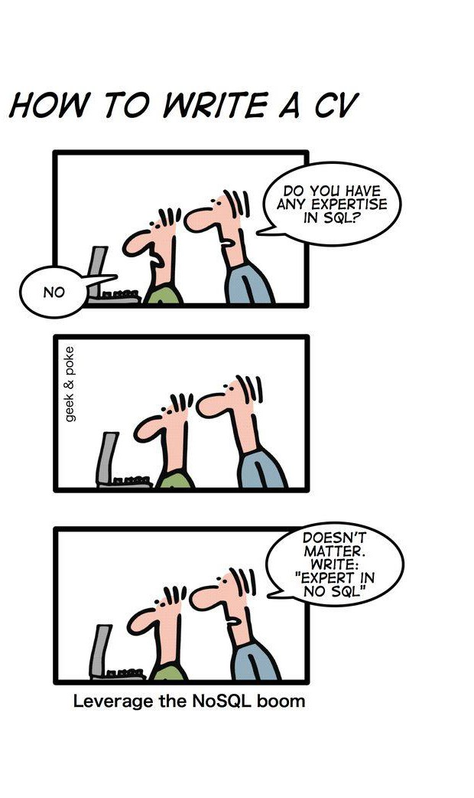
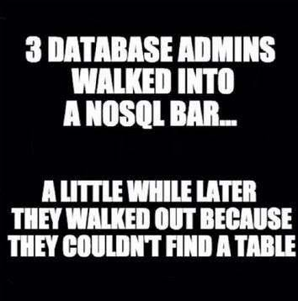
NoSQL

Slide 2
NoSQL
Does not follow database design principles we have studied till now
Designed to achieve high scale and elasticity needed for “Web 2.0” applications
NoSQL stands for “Not Only SQL”
Not everyone agrees on this

Slide 3
Motivation
Two broad classes of database workloads
Online Transaction Processing (OLTP)
Online Analytical Processing (OLAP)
OLTP:
Characterized by high number of transactions executed by large number of users. Also involve high number of updates.
Common for application like social media, online stores
Queries are simple lookups (search user by id, get items in shopping cart) and
updates (make posts, add items to cart, like photos)
Rarely include any joins
Consistency is needed therefore transactions are performed

Slide 4
Motivation
OLAP:
Read-only workloads characterized by queries that run on large amount of
data
Large number of joins and aggregations are involved
Queries are written to support business decision making (Total revenue generated by each store, each manager, each product, each year)

Slide 5
Methods for scaling databases
Partitioning
Database is portioned into segments of data that spread out over multiple
machines
Performance increases due to partitioning because
Parallel execution of queries
Each partition can fit into memory therefore reducing disk I/O cost
Read-only workloads may suffer if query accesses data spanning multiple machines

Slide 6
Methods for scaling databases
Replication
Provides support to scaling, resilient to failures
Queries executing on same data can run in parallel
As replicas increase, writes becomes increasingly expensive
Partitioning and replication are used together to make system more fault-tolerant
How system will respond when machines begin to fail, and the network makes no guarantees about ordering and successful delivery of messages

Slide 7
Why is it hard to scale relational databases? (1)
For web application, web browsers are considered clients
Number of clients connecting to database are in 100s of millions
Application servers can be replicated to meet the scaling requirements. This is easier to do because application servers do not share state
Common state is handled by a database backend which communicates with application servers
Single database server cannot handle this high OLTP load

Slide 8
Why is it hard to scale relational databases? (2)
3 important properties of distributed systems:
Consistency – Simultaneous requests should get same view of data
Availability – Every valid request must receive a response that is not an error
Partition Tolerance- System must continue to operate when network fails
CAP Theorem – Proves that it is not possible to build a distributed system to simultaneously provide more than two of these three properties

Slide 9
Why is it hard to scale relational databases? (3)
Distributed system preference:
Consistency: Show error if data view does not have recent updates
Availability: Always provide a data view it can access
Eventual consistency: It guarantees that eventually all copies of data will become consistent.
Relational database systems are difficult to scale in such scenario, but NoSQL can.

Slide 10
NoSQL
Web 2.0 helped boom web applications to incorporate more user- generated content and interactions between users
OLTP workloads involve photos, likes, videos, upvotes, etc., being inserted and queried by millions of users simultaneously.
Relational databases were too restrictive and not all its functionalities were useful
NoSQL has simpler data model with restricted updates that can handle a higher volume of simple updates and queries

Slide 11
NoSQL Data Models (1)
Key-Value Stores:
Consists of (key, value) pairs
“value” is a string or byte array (Unstructured data)
Key identifies a record
Operations: only two, get(key), put(key, value)
Examples: DynamoDB

Slide 12
NoSQL Data Models (2)
Wide-Column Stores:
Stores data in tables, rows, and dynamic columns
Each row in a table may not have same columns
Operations: get(key, [columns]), put(key, value)
Example: Apache Cassandra, HBase

Slide 13
NoSQL Data Models (3)
Document Stores:
These are most structured among all other data models
Key, value stores whose values follow data format (Semi-structured) like JSON, XML are called document stores, values are called documents
Has collections instead of tables, and documents instead of tuples

Slide 14
JSON Format
Data is in name / value pairs
A name/value pair consists of a field name followed by a colon, followed by a value:
Example: “name”: “R2-D2”
Data is separated by commas
Example: “name”: “R2-D2”, race : “Droid”
Curly braces hold objects
Example: {“name”: “R2-D2”, race : “Droid”, affiliation: “rebels”}
An array is stored in brackets []
Example [ {“name”: “R2-D2”, race : “Droid”, affiliation: “rebels”}, {“name”: “Yoda”,
affiliation: “rebels”} ]

Slide 15
Mongosh Shell
show dbs: list databases
use <db>: switch databases
show collections: list collections
db.<collection>.<operation>(<args>)

Slide 16
Operations on Collection
.insertOne(doc): insert document
doc is a document (JavaScript object)
.insertMany(docs): insert multiple
<docs> is an array of documents
.find([query]): retrieve documents
With no query, get all documents
query is a document; finds documents with matching key/values
E.g. db.students.find({ id: “john" })
.findOne([query]): retrieve first document
(Mostly) no guaranteed order

Slide 17
Query Operators
Use query operators for complex searches
Operators start with $
$gt, $lt, $gte, $lte: comparison
E.g. db.courses.find({ units: {$gte: 2} })
$in: matches element in array
E.g. db.students.find({ id: {$in: [“John", “Roy"]} })
$regex: match text (regular expression)
E.g. db.courses.find({ code: {$regex: "^CS532"} })

Slide 18
Query Operators
$eq - Matches value that are equal to a specified value
$gt, $gte - Matches values that are greater than (or equal to a specified value
$lt, $lte - Matches values less than or ( equal to ) a specified value
$ne - Matches values that are not equal to a specified value
$in - Matches any of the values specified in an array
$nin - Matches none of the values specified in an array
$or - Joins query clauses with a logical OR returns all
$and - Join query clauses with a loginal AND
$not - Inverts the effect of a query expression
$nor - Join query clauses with a logical NOR
$exists - Matches documents that have a specified field

Slide 19
Update, delete
.replaceOne(query, doc)
Replace first document matching query with doc
.deleteOne(query)
.deleteMany(query)
Delete document(s) matching query
.updateOne(query, update)
.updateMany(query, update)
Apply update operations to document(s) matching query

Slide 20
Update Operation
db.collection_name.insert( <document> )
Omit the _id field to have MongoDB generate a unique key Example db.parts.insert( {{type: “screws”, quantity: 15 } ) db.parts.insert({_id: 10, type: “hammer”, quantity: 1 })
db.collection_name.save( <document> )
Updates an existing record or creates a new record
db.collection_name.update( <query>, <update>, { upsert: true } )
Will update 1 or more records in a collection satisfying query
db.collection_name.findAndModify(<query>, <sort>, <update>, <new>,
<fields>, <upsert>)
Modify existing record(s) – retrieve old or new version of the record

Slide 21
Examples
db.user.insert({
first: "John",
last : "Smith",
age: 31
})
db.user.find ()
{ "_id" : ObjectId("15"),
"first" : "John",
"last" : " Smith ", "age" : 31
}
db.user.update(
{"_id" : ObjectId(“15")},
{
$set: { age: 35,
salary: 9000}
}
)

Slide 22
MongoDB Tutorials
https://www.mongodbtutorial.org/

